Slide 1
What personal qualities do you think a person would need to become a billionaire in today’s world?

Slide 2
Trusts and Cartels
11.2.5: Examine corporate mergers that produced trusts and cartels and the economic and political policies of industrial leaders.

Slide 3
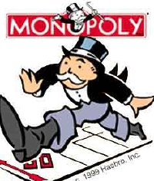
In the late 19th century, the growth of corporate mergers and trusts led to monopolies, in which one company controlled an entire industry.

Slide 4
Corporations usually accomplished a merger by buying out the stock of another corporation.

Slide 5
In trust agreements, companies turn over their stock to a group of trustees who run the companies as one large company. The separate companies are entitled to large profits and dividends that the trust earns.

Slide 6
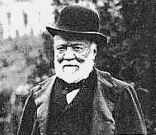
Andrew Carnegie
Carnegie Steel

Slide 7
Business Practices
1. Make products more cheaply

Slide 8
Business Practices
2. vertical integration – A company’s taking over its suppliers, distributors and transportation systems to gain control over the quality and cost of its product.
All things needed to make and transport steel (coal fields, iron mines, ore freighters, RR lines)

Slide 9
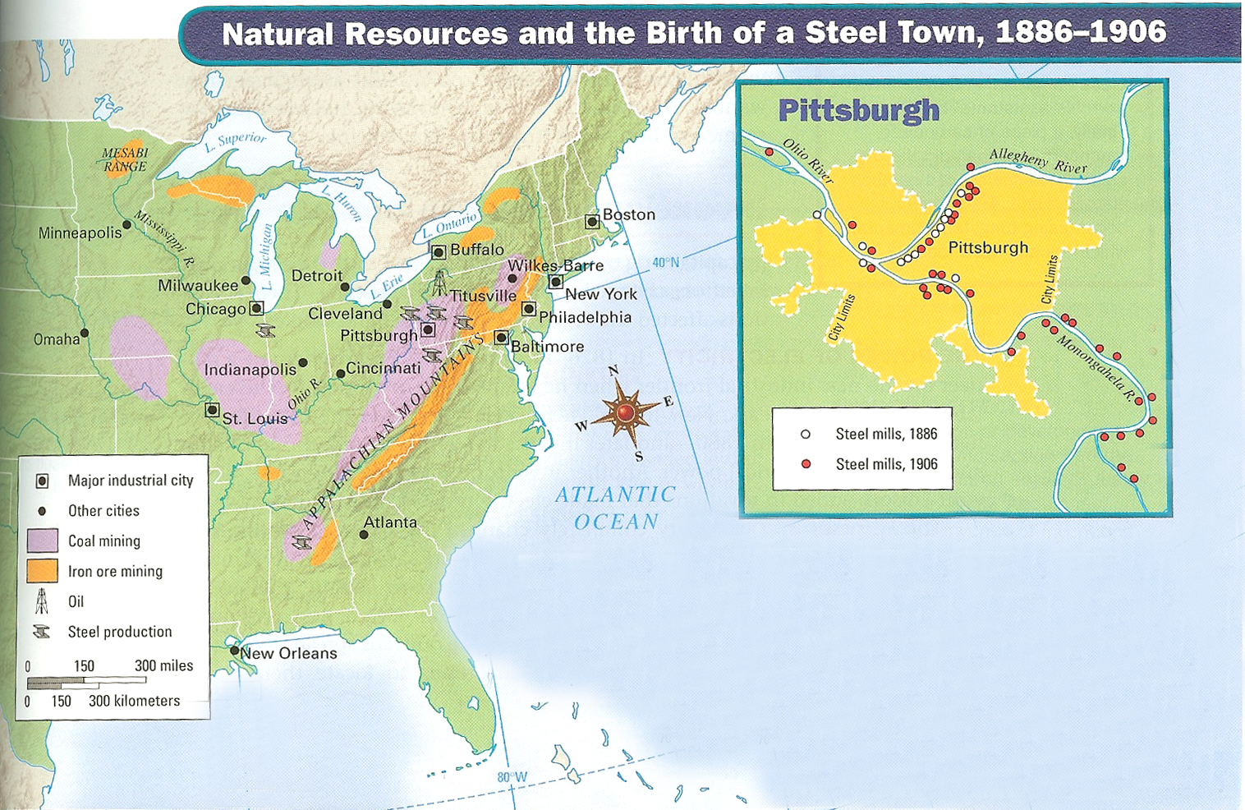
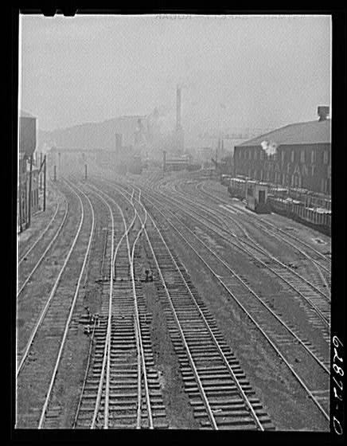
Results: 1. Through Vertical Integration, Carnegie controlled the resources, manufacturing, and distribution of steel.

Slide 10
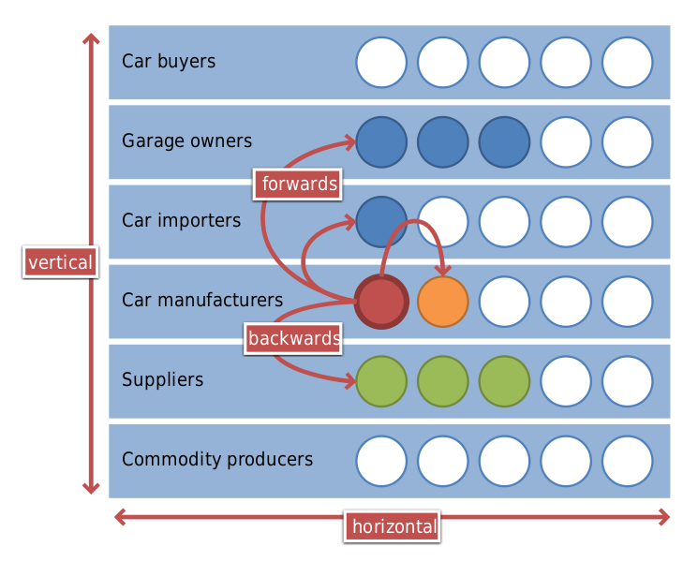
Business Practices
Results
3. horizontal integration – the merging of companies that make similar products.
Example of both:
2. Carnegie Steel became the largest steel manufacturer in the country.

Slide 11
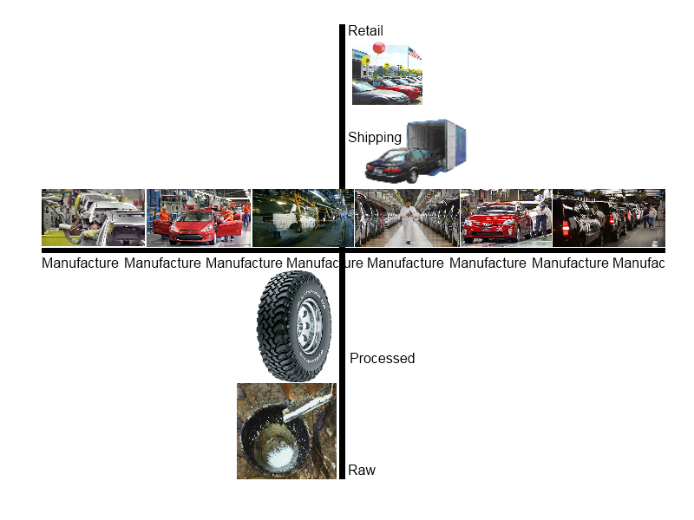
_____________ Integration
___________Integration
Quickwrite #1: Using this image as reference please explain Carnegie’s business strategies in the steel industry. Include the integration strategies in your answer. (2 Sentences)

Slide 12
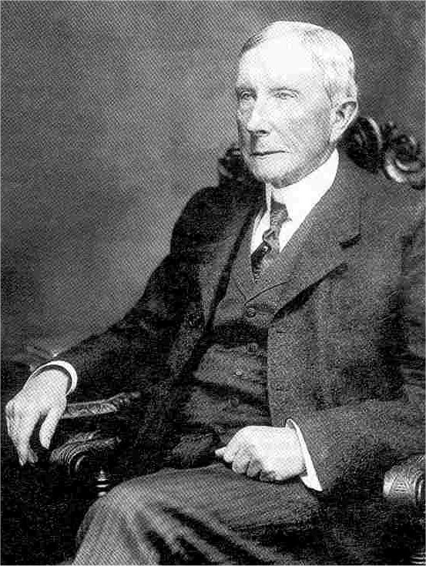
John D. Rockefeller
Standard Oil Company

Slide 13
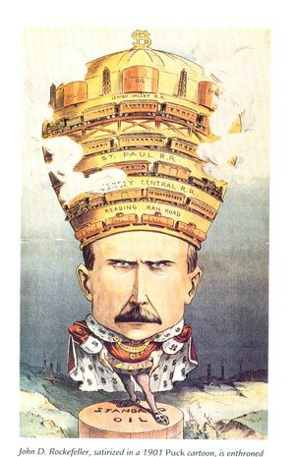
Business Practices
Results
1. Standard Oil entered into trust agreements with competing oil companies
1. By 1880s, Standard Oil controlled 90% of the oil refining business

Slide 14
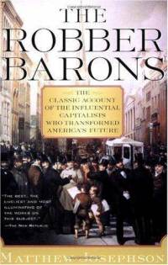
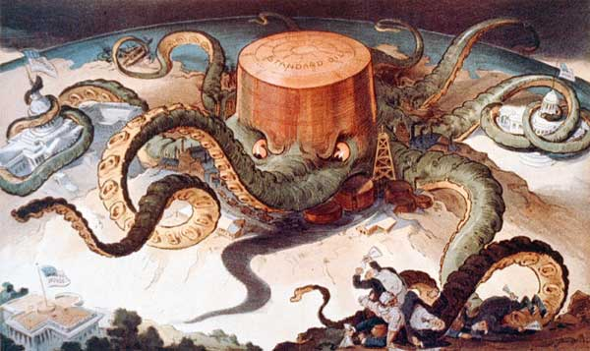
Business Practices
Results
2. Wealthy by paying low wages, driving out competition and raising oil prices once competition was gone.
2. Rockefeller was labeled a robber baron for his ruthless tactics

Slide 15
Quick write #2: Why did people like John D. Rockefeller get labeled a Robber Barron? Do you think that label was fair?

Slide 16
Sherman Antitrust Act
In response to concerns that corporate mergers were becoming a threat to competition, Congress passed the Sherman Antitrust Act in 1890.

Slide 17
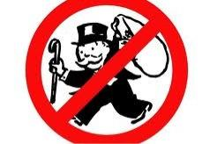
Sherman Antitrust Act
This act made it illegal for companies to create trusts that interfered with free trade between states or with other countries.

Slide 18
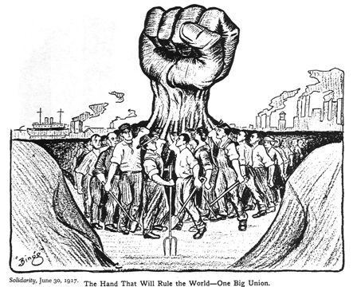
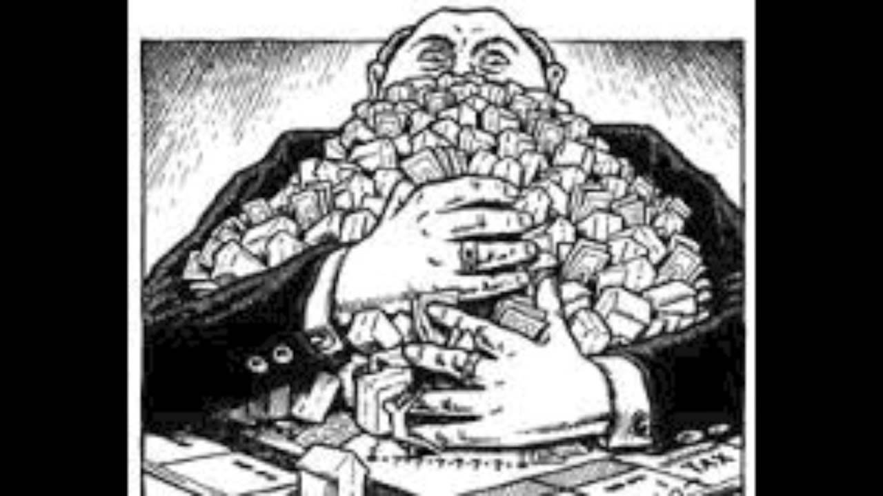
Sherman Antitrust Act
The act was difficult to enforce and was ineffective in breaking up big businesses. Business leaders eventually used it against labor union activities, which they claimed interfered with free trade.

