Slide 1
Progressivism
11.2.9: Understand the effect of political programs and activities of the Progressives.

Slide 2
Four Basic Goals of Progressivism
1. Protect social welfare by changing some of the harsh conditions of industrialization.

Slide 3
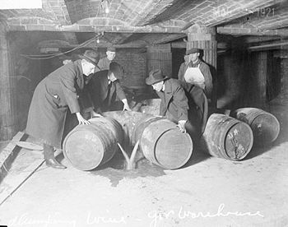
Four Basic Goals of Progressivism
2. Promote moral improvement through religious work and prohibiting alcoholic drinks.

Slide 4
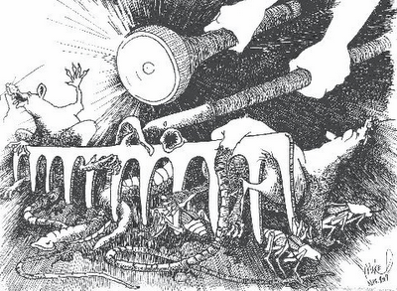
Four Basic Goals of Progressivism
3. Create economic reform by limiting the power of large corporations.

Slide 5
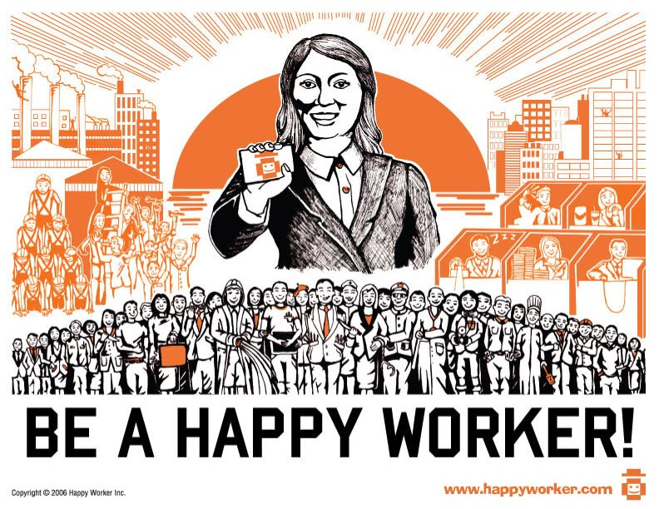
Four Basic Goals of Progressivism
4. Increase efficiency in industry and government by using scientific principles

Slide 6
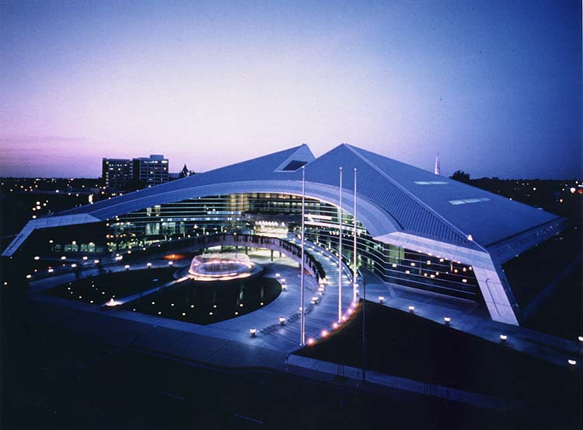
Reforms at Local, State and National Levels
Local government- elected mayors to reduce corruption and helped people take active role in government.

Slide 7
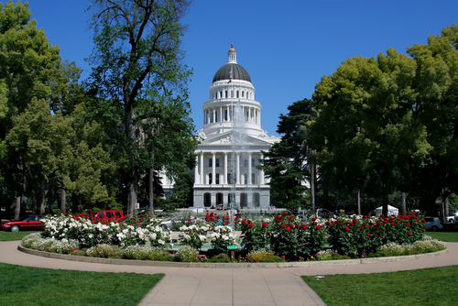
State Government
1. Initiative: the right to present a new bill or measure originated by the people.
2. Referendum: the measure can be submitted to a vote of the people.
3. Recall: procedure to remove a public figure from office.
4. 17th Amendment:
People directly elect U.S.
Senators

Slide 8
Example: Hiram Johnson was elected Governor of California in 1910 and regulated railroads. He allowed people to vote directly on some laws, established labor laws to protect workers, and promoted women’s suffrage.

Slide 9
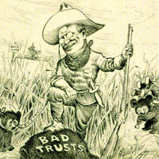
National Government
President Theodore Roosevelt tried to strengthen federal regulation of trusts. He was known as a “Trustbuster”.

Slide 10
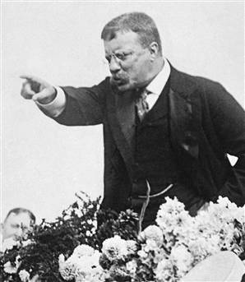
National Government
He got Congress to pass new laws regulating RR’s. New laws also required inspection and regulation of food and drugs and established environmental protection and conservation through national parks.

Slide 11
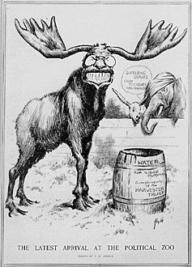
Progressive Party – “The Bull-Moose Party”
When Taft didn’t accomplish as much as some Progressives wanted, Theodore Roosevelt helped form the Progressive party in 1912. It was called “The Bull-Moose Party” because Roosevelt said he was as strong and fit as a “bull moose.”

Slide 12
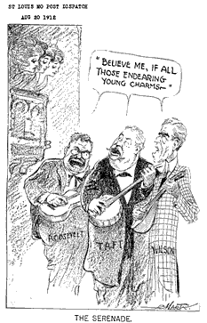
Progressive Party – “The Bull-Moose Party”
Roosevelt beat the Republican Taft, but Democrat Woodrow Wilson won more votes than either. Wilson adopted many Progressive reforms. The party died out in 1917.

Slide 13
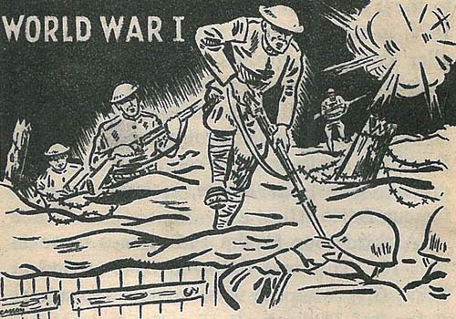
Progressivism and World War I
International problems that resulted in WWI became more important to people than reforms in the United States. Some of the Progressive reforms were accomplished after the war, such as women’s suffrage and Prohibition.

